Slide 1
Mess Management System
Developed by
Zakaria Ahmmed
Under Supervision
Abdul Bari

Slide 2
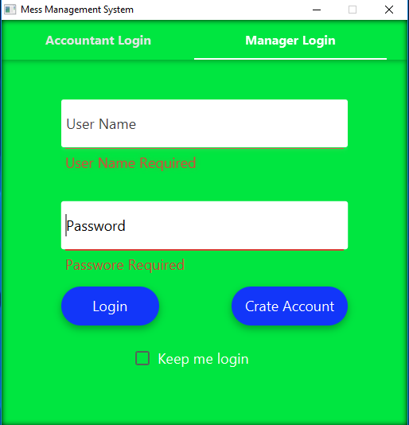
Login Page
Two Way Login
Accountant Login
Manager Login

Slide 3
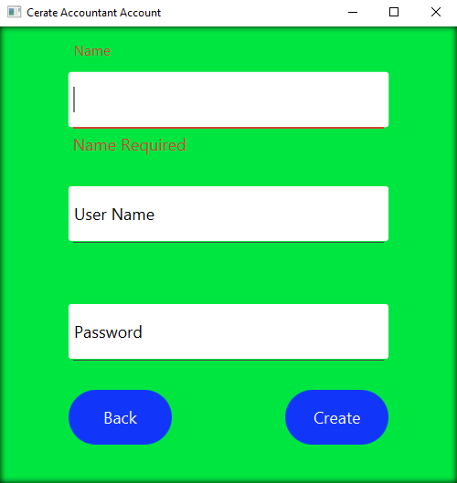
Create Accountant Account

Slide 4
Create Manager Account

Slide 5
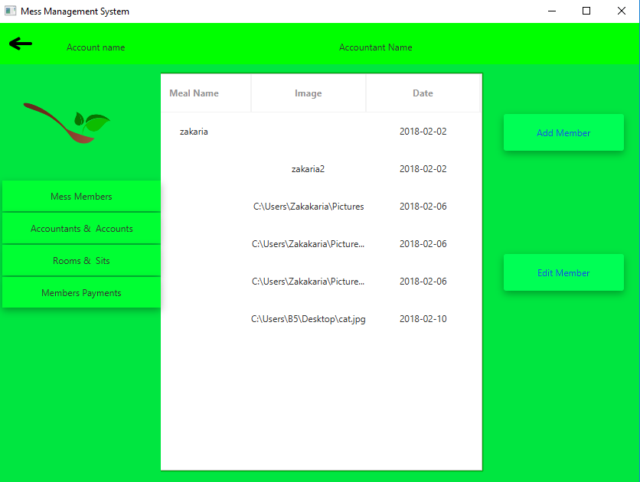
Manager Welcome Window
Add Members
View Accounts
Manage Rooms & Sits
Member Payment Management

Slide 6
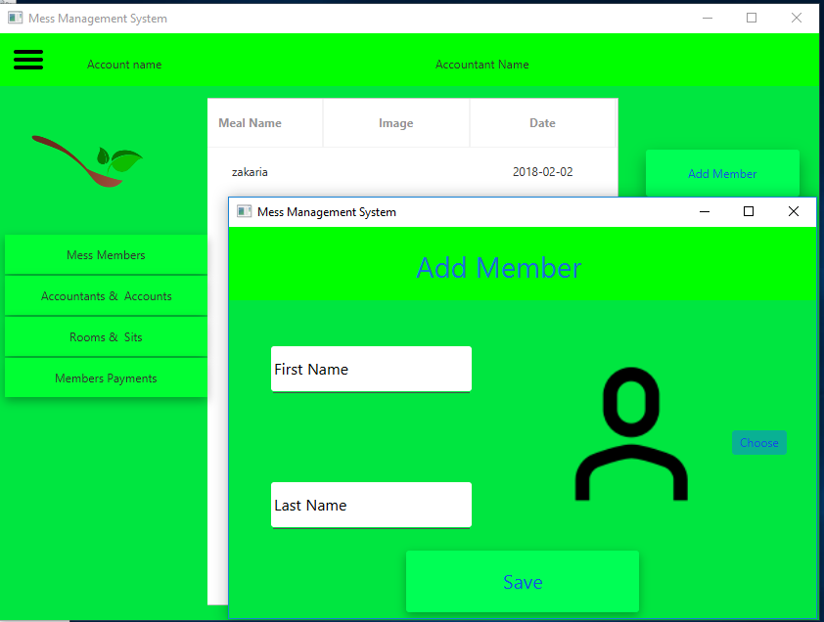
Add Member Window
Add Members
View Accounts
Manage Rooms & Sits
Member Payment Management

Slide 7
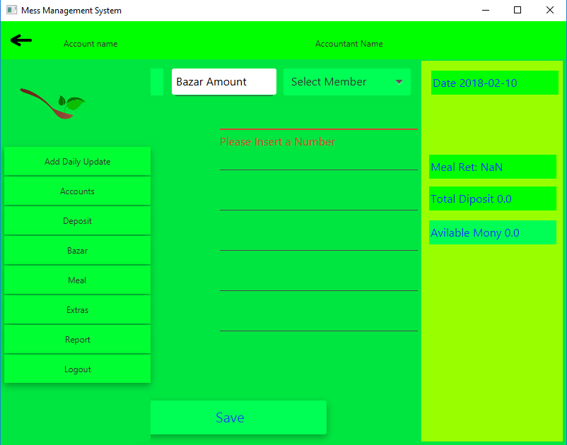
Accountant Welcome Window
Create Meal Account
Daily Meal Update
Deposit
Bazar
Meal
Extras
Report
Logout

Slide 8
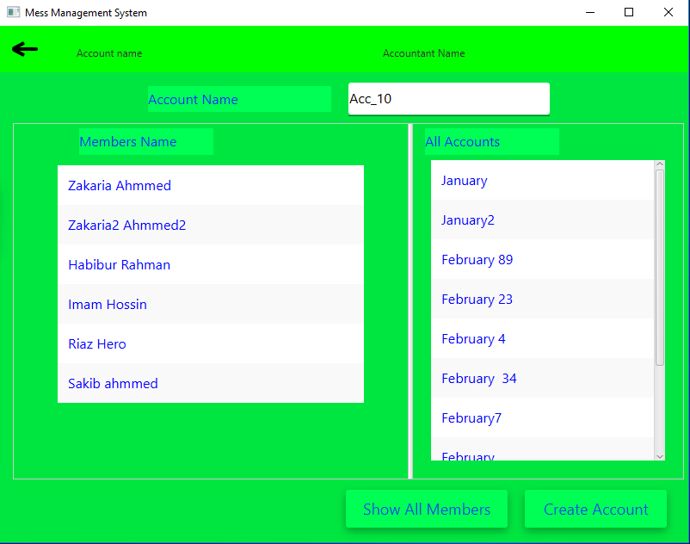
Create Account Window
Accountant Can Create an Account
Accountant can View his previous accounts
Accountant can view all available members In mess

Slide 9
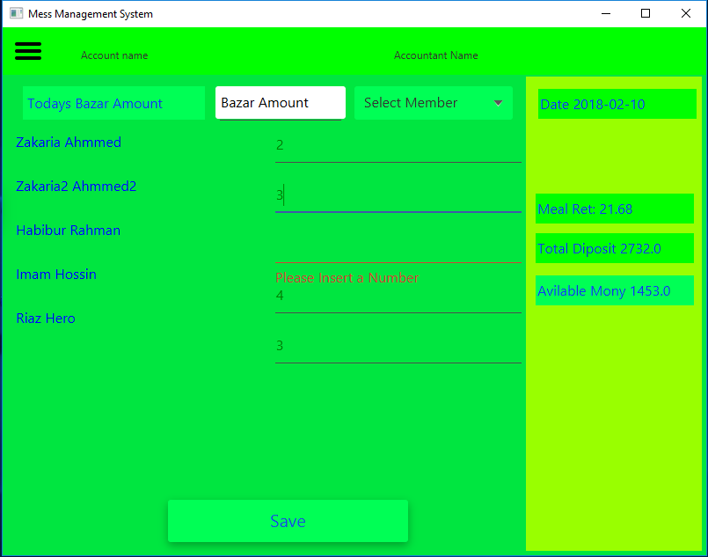
Daily Meal Update
Add daily bazar
Add daily meal
Accountant can view current status of meal

Slide 10
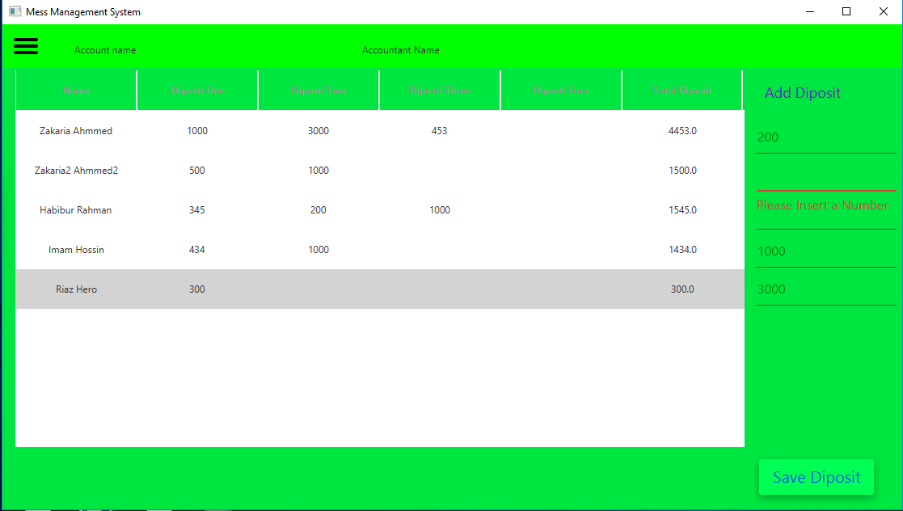
Deposit Section
Accountant can add deposit
Accountant can view previous deposit
Accountant can view each member total diposit

Slide 11
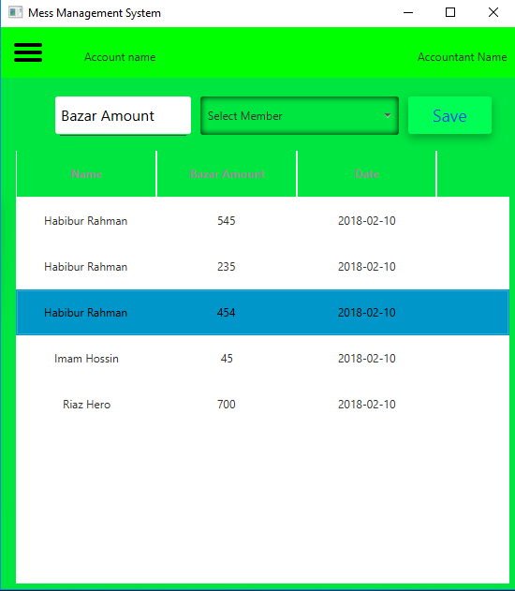
Bazar Section
Accountant can add bazar
Accountant can view all bazars

Slide 12
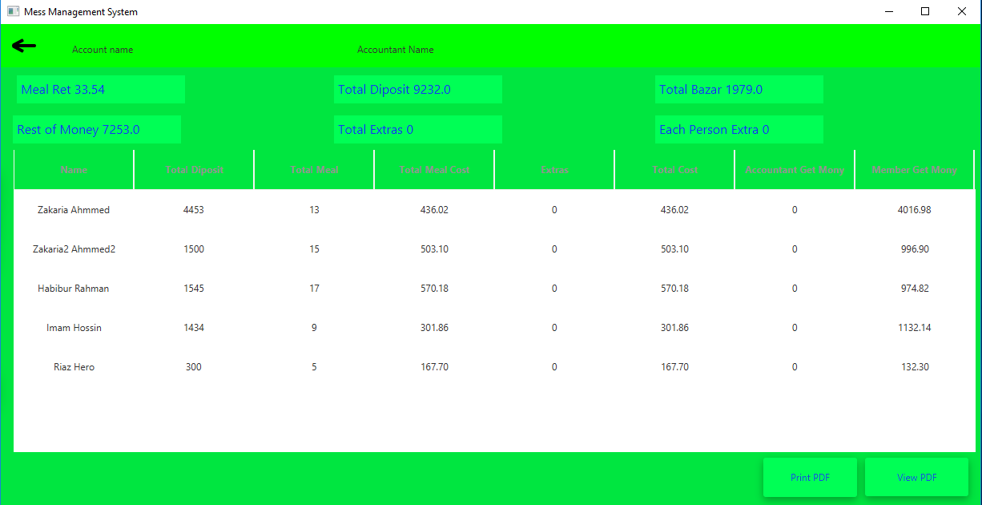
Monthly Report

